Slide 1

The following slides are for use with UCAR Center for Science Education’s Blooming Thermometers classroom activity
Note: This file has View Only permissions. From the File menu, you can make a copy or download this file for use in your classroom. You do not need to request edit access to view, copy, or download.
Notes:
The Blooming Thermometers lesson is available at: https://scied.ucar.edu/activity/blooming-thermometers

Slide 2
Blooming Thermometers
What can cherry trees tell us about climate?

Slide 3
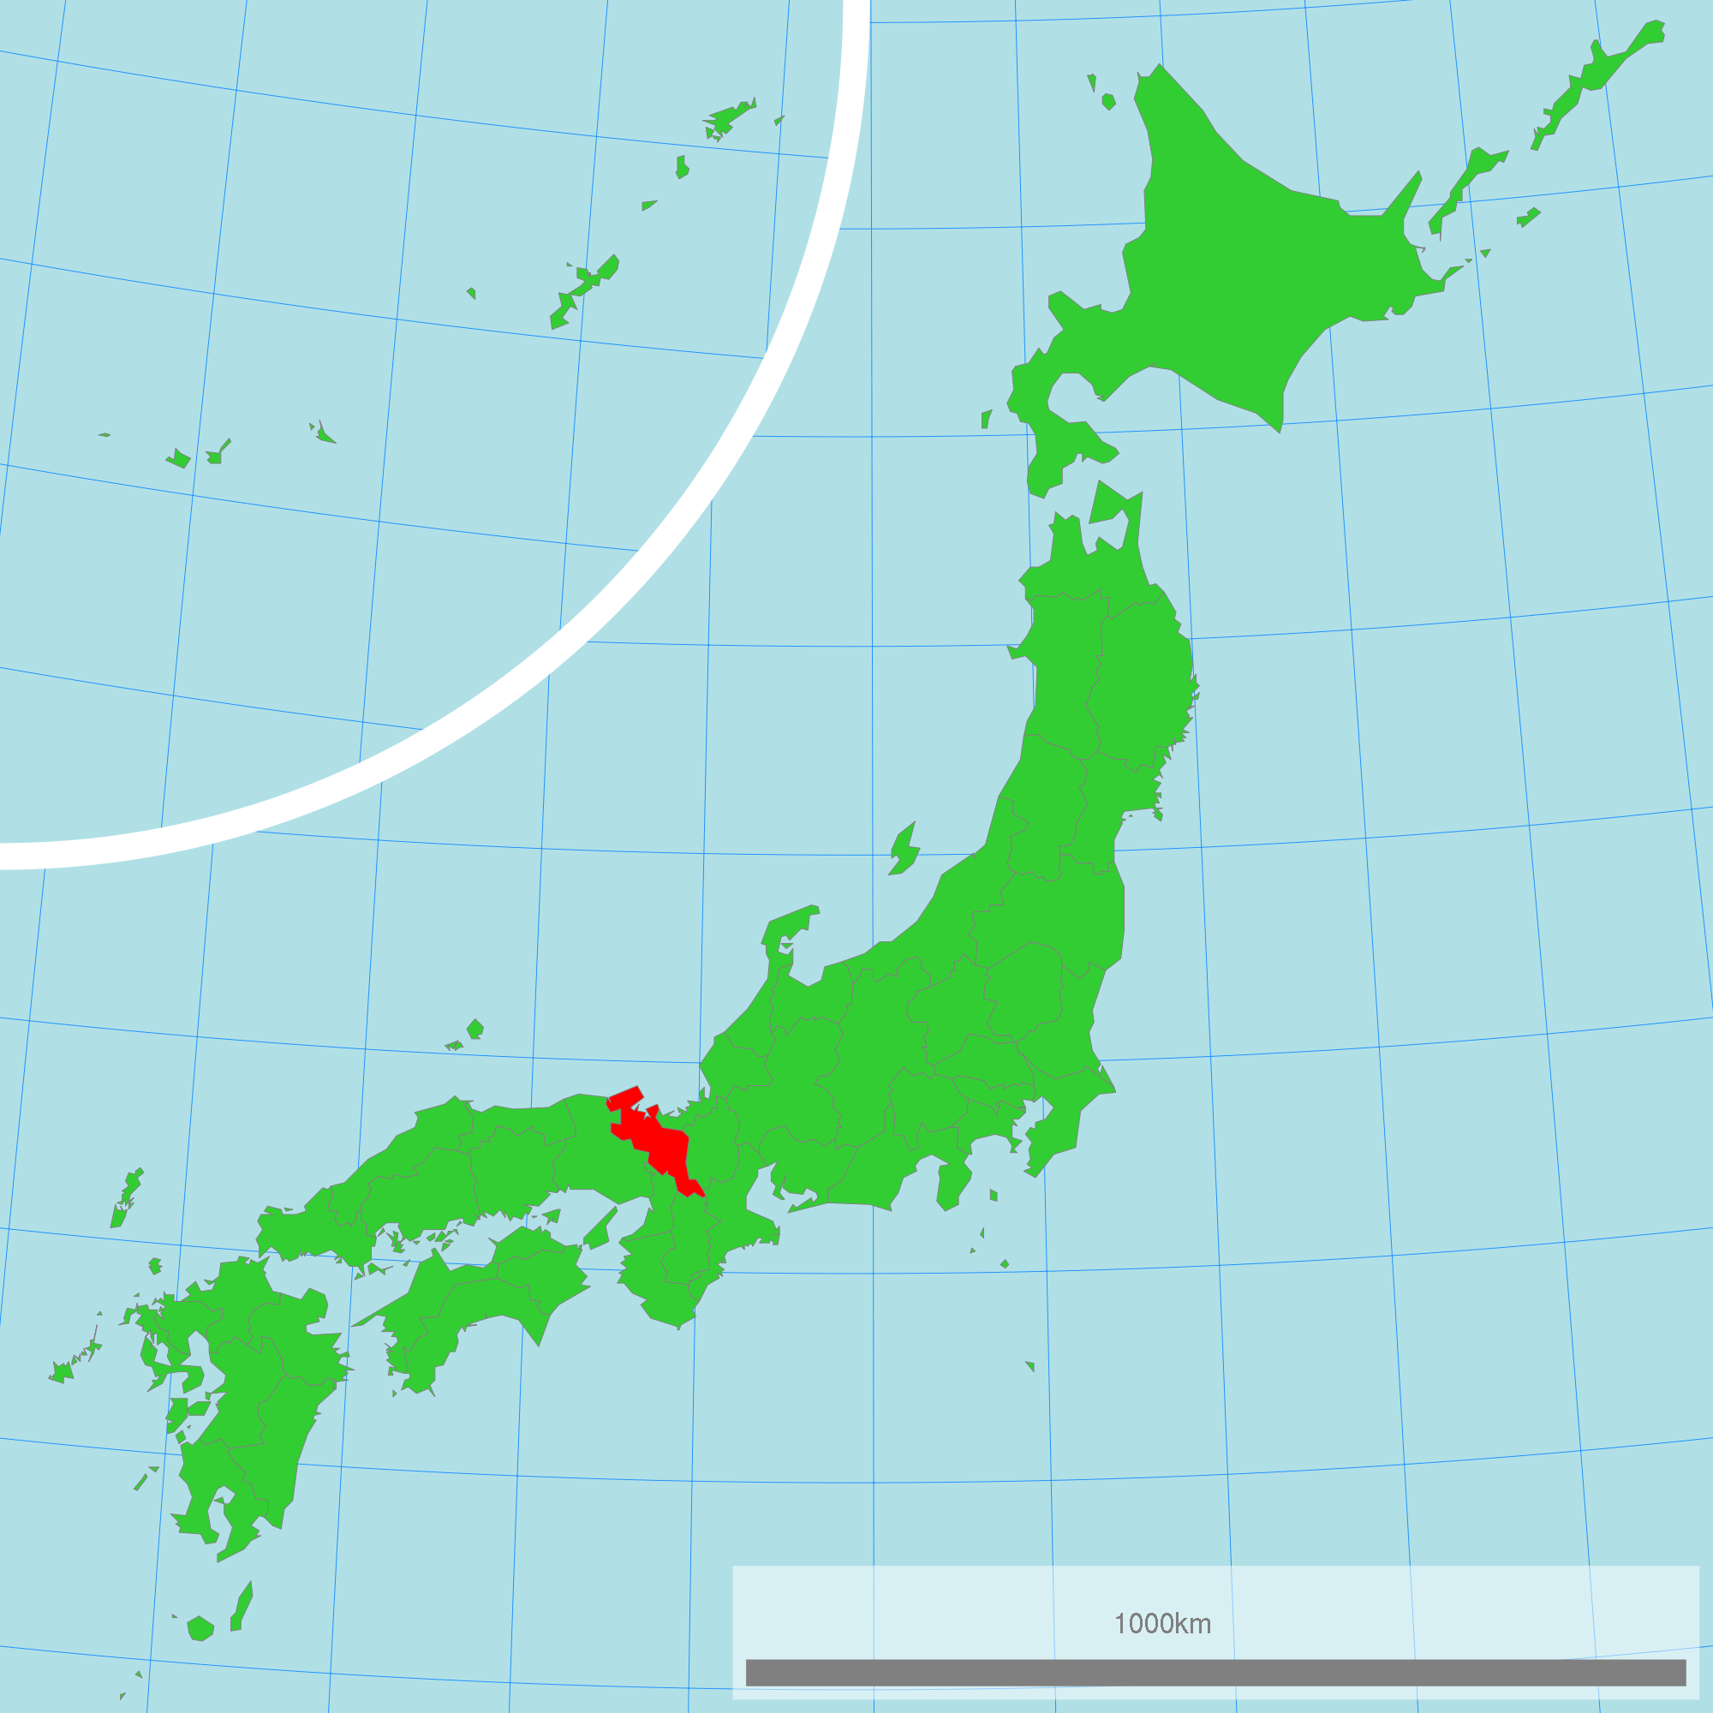
In Kyoto, Japan...
Credit: Wikipedia

Slide 4
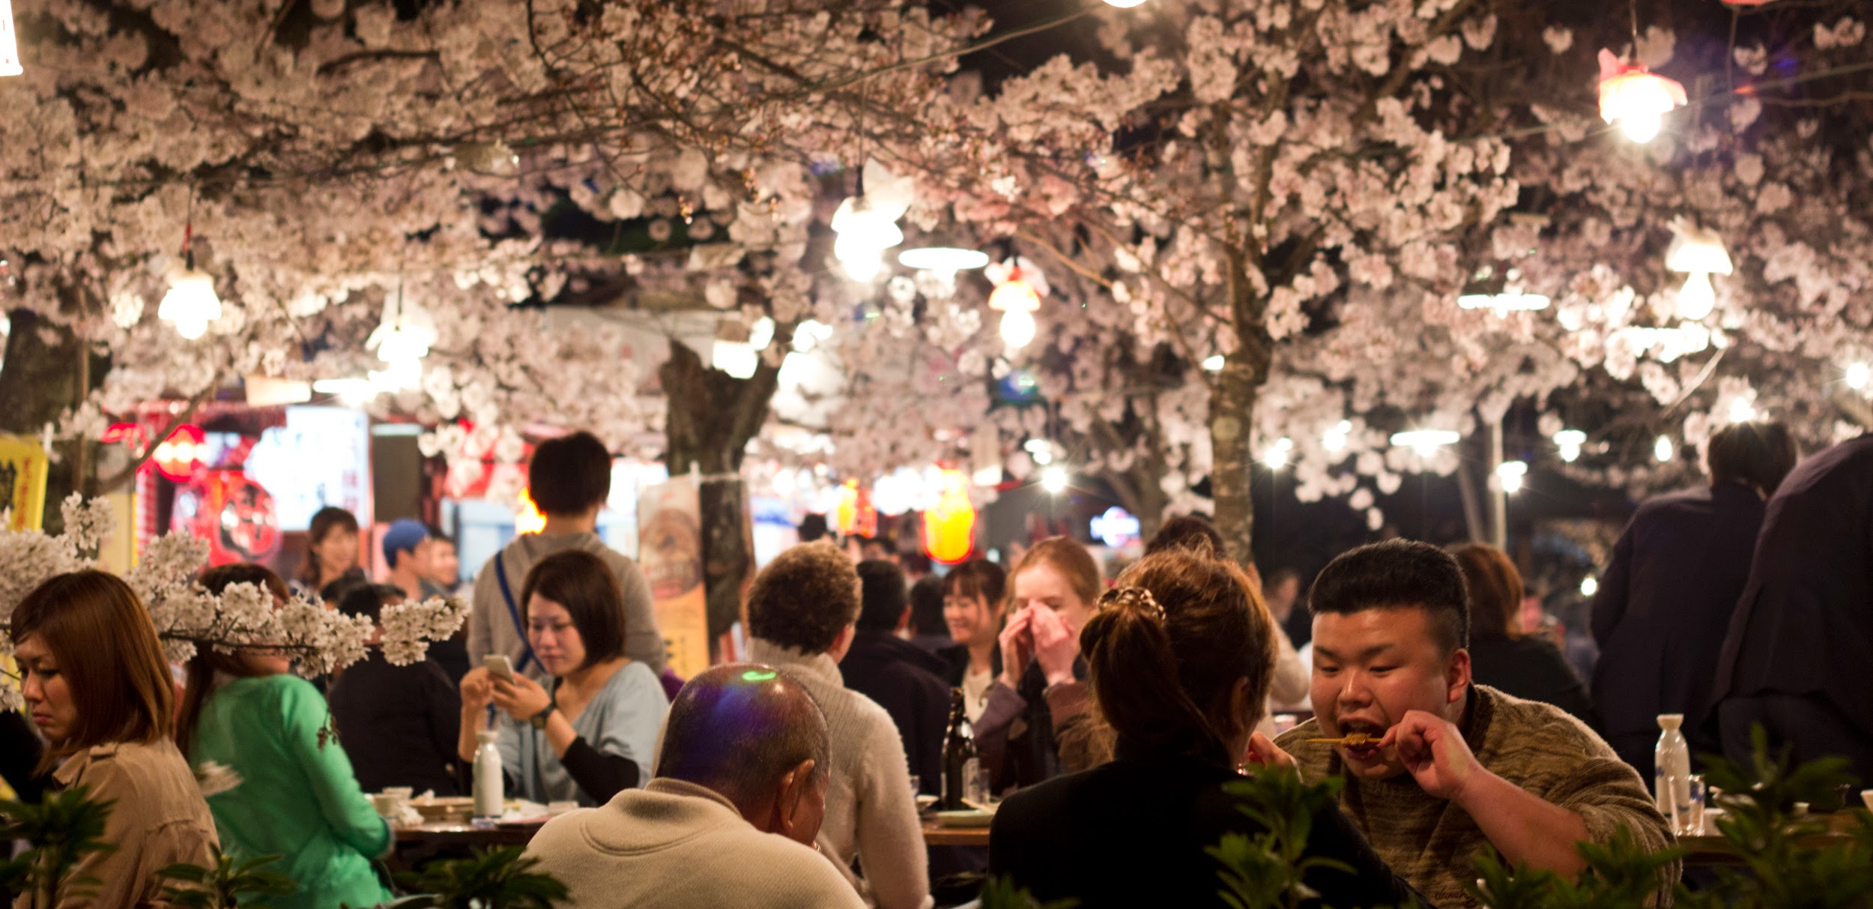
...there is a cherry blossom festival each spring.
Cherry Blossom Festival in Maruyama Park, Kyoto 2014
Credit: Marcus/Japanexperterna.se

Slide 5
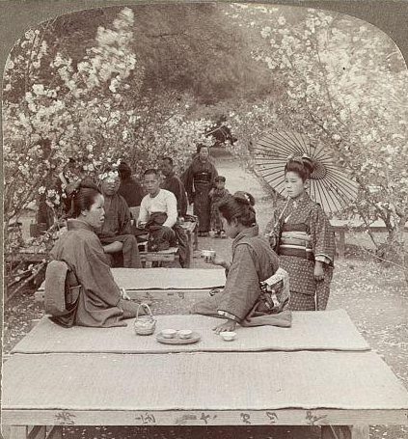
In Japan, people were watching the cherry trees bloom over a hundred years ago...
Tea in a garden of dwarf cherry trees, Japan (1904).
Credit: Library of Congress, photo by Underwood & Underwood

Slide 6
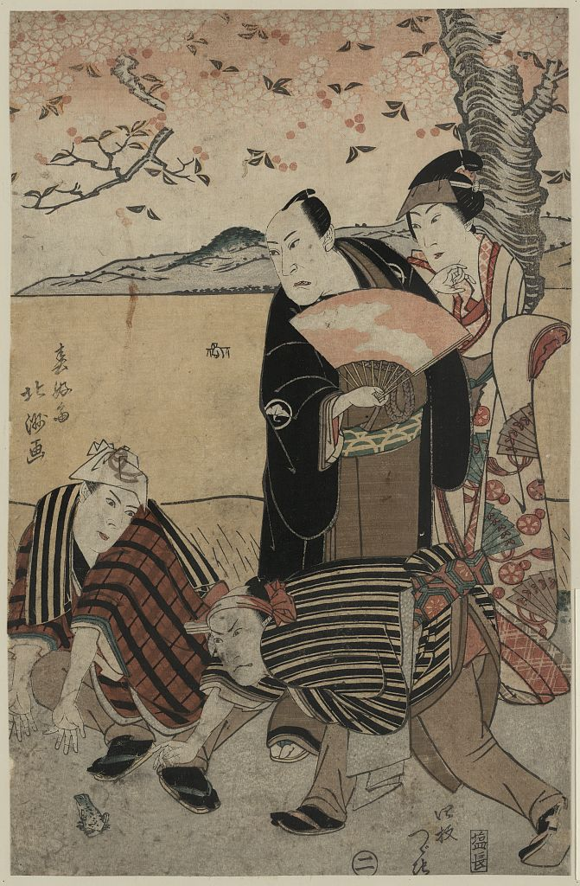
...and about 200 years ago.
Woodcut print showing four actors under a flowering cherry tree.
Credit: Library of Congress, art by Shunkōsai, Hokushū

Slide 7
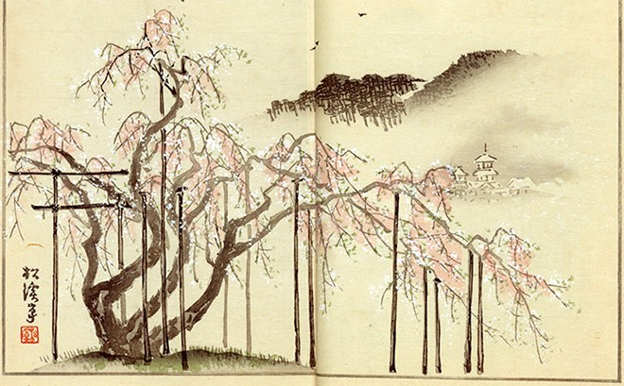
In fact, there are records of when Japanese cherry trees bloomed over 1000 years ago.
Credit: Library of Congress

Slide 8
What can the blooming cherry trees tell us about climate?

Slide 9
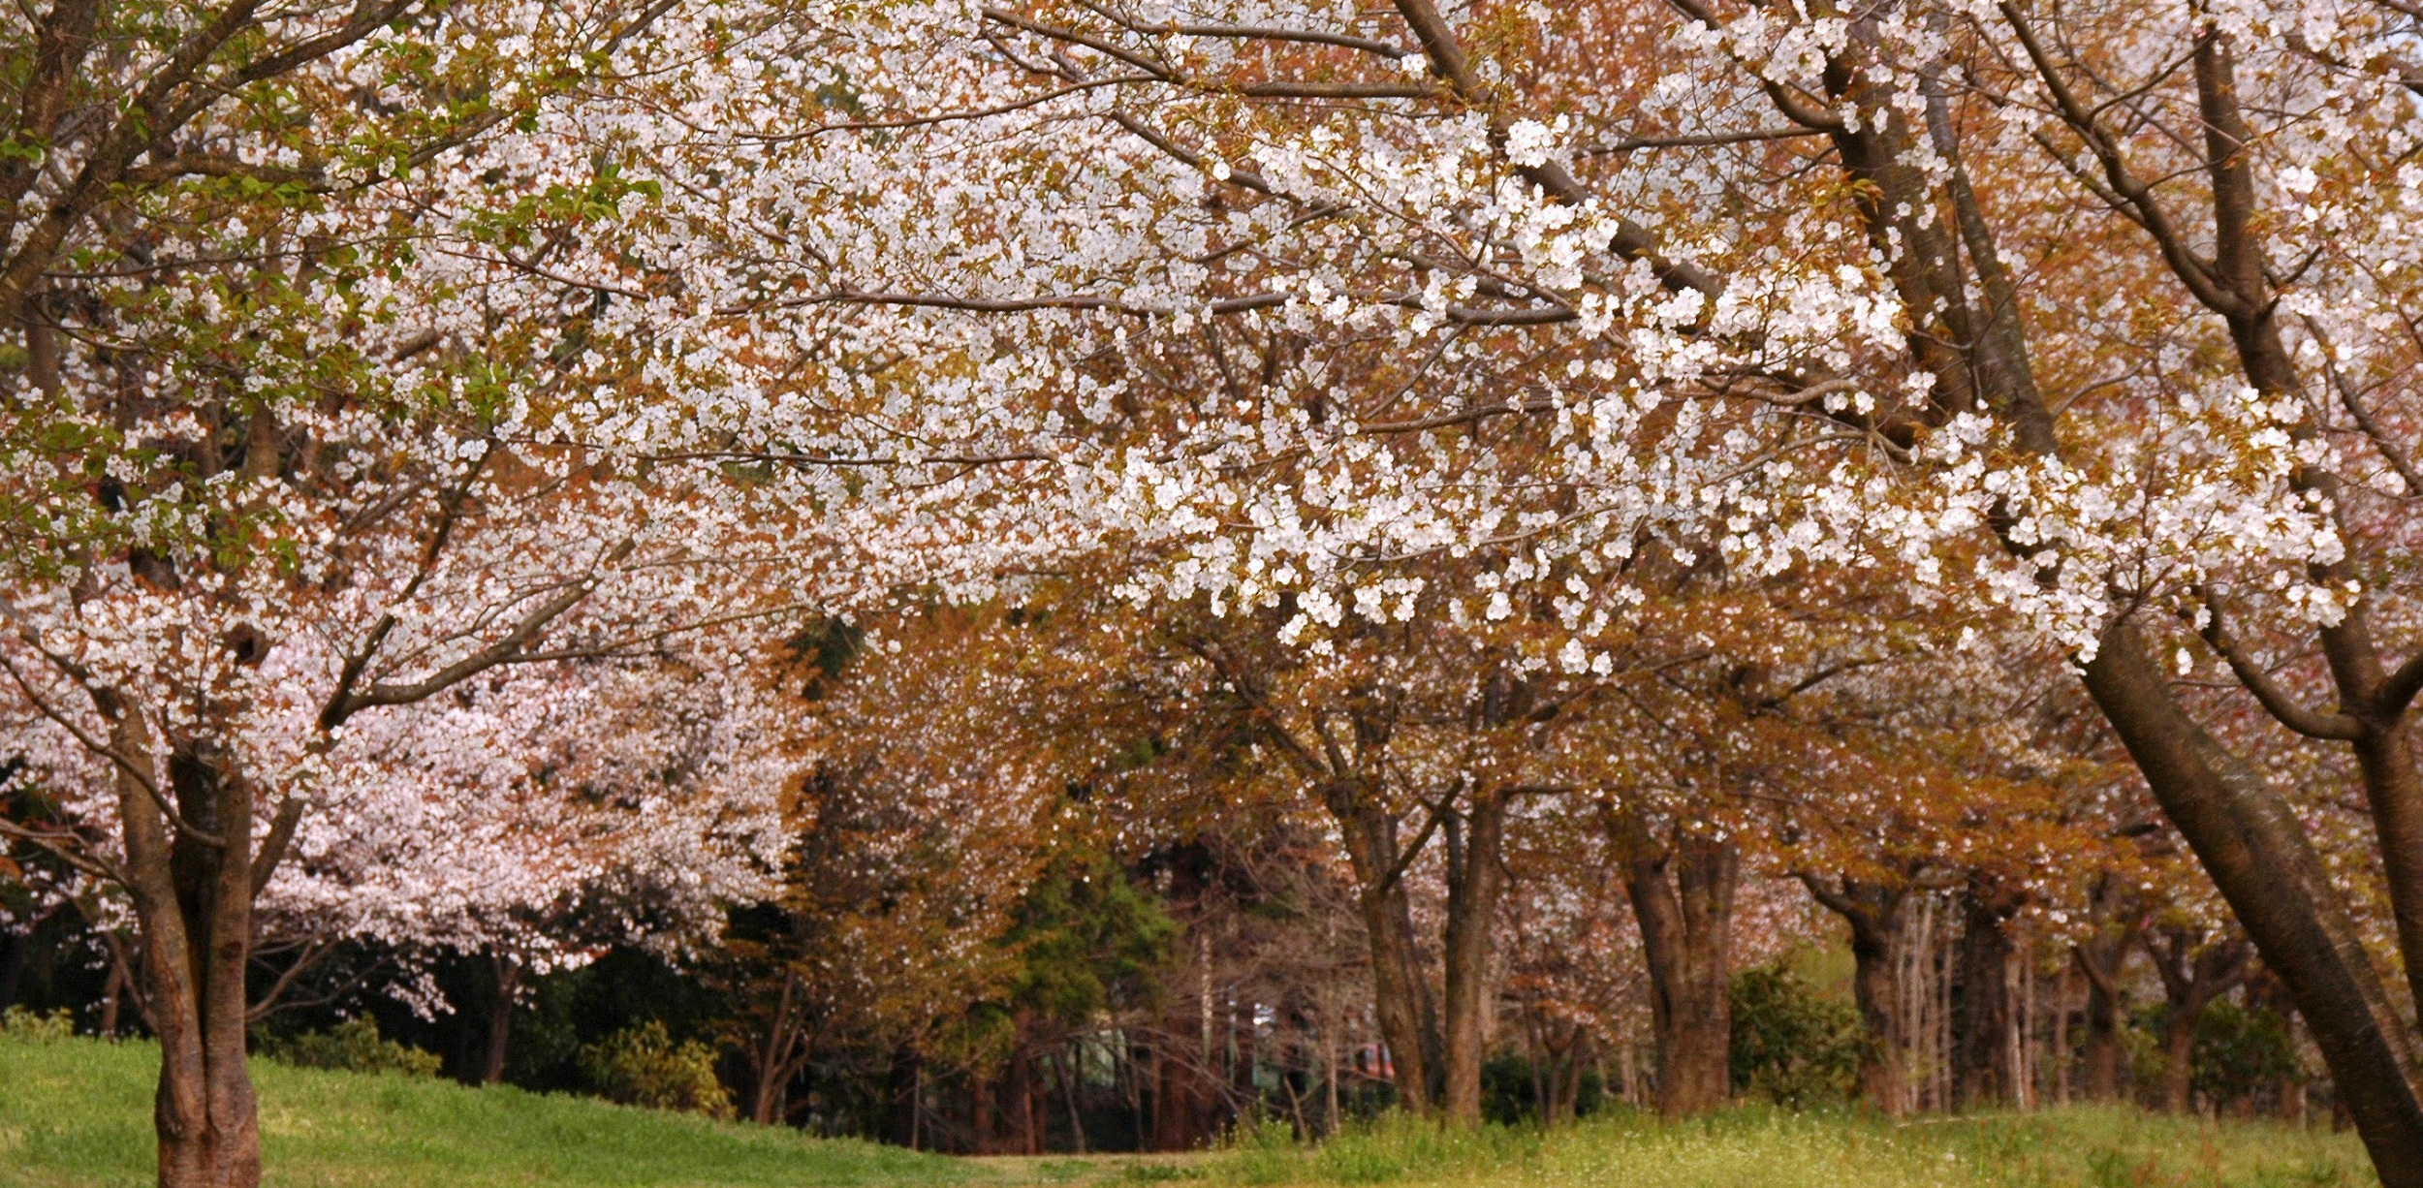
Cherry trees bloom when it warms in the spring.

Slide 10
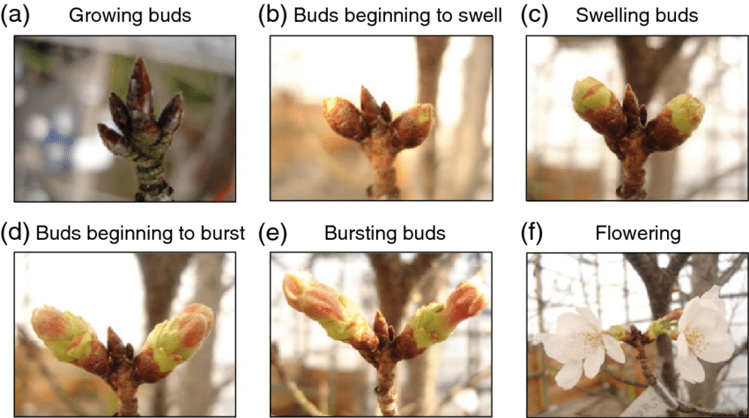
When the temperature is warm enough, the buds on the trees grow, swell, burst, and then the flowers open.

Slide 11
Figure it out:
Analyze cherry blossom data as evidence of past and present climate.
Use the mean (average) bloom date data on your student page to make a bar graph of how bloom date has changed over time.
Notes:
Part 1 activity in the teacher guide
Students will need the Blooming Thermometers Student Page.

Slide 12
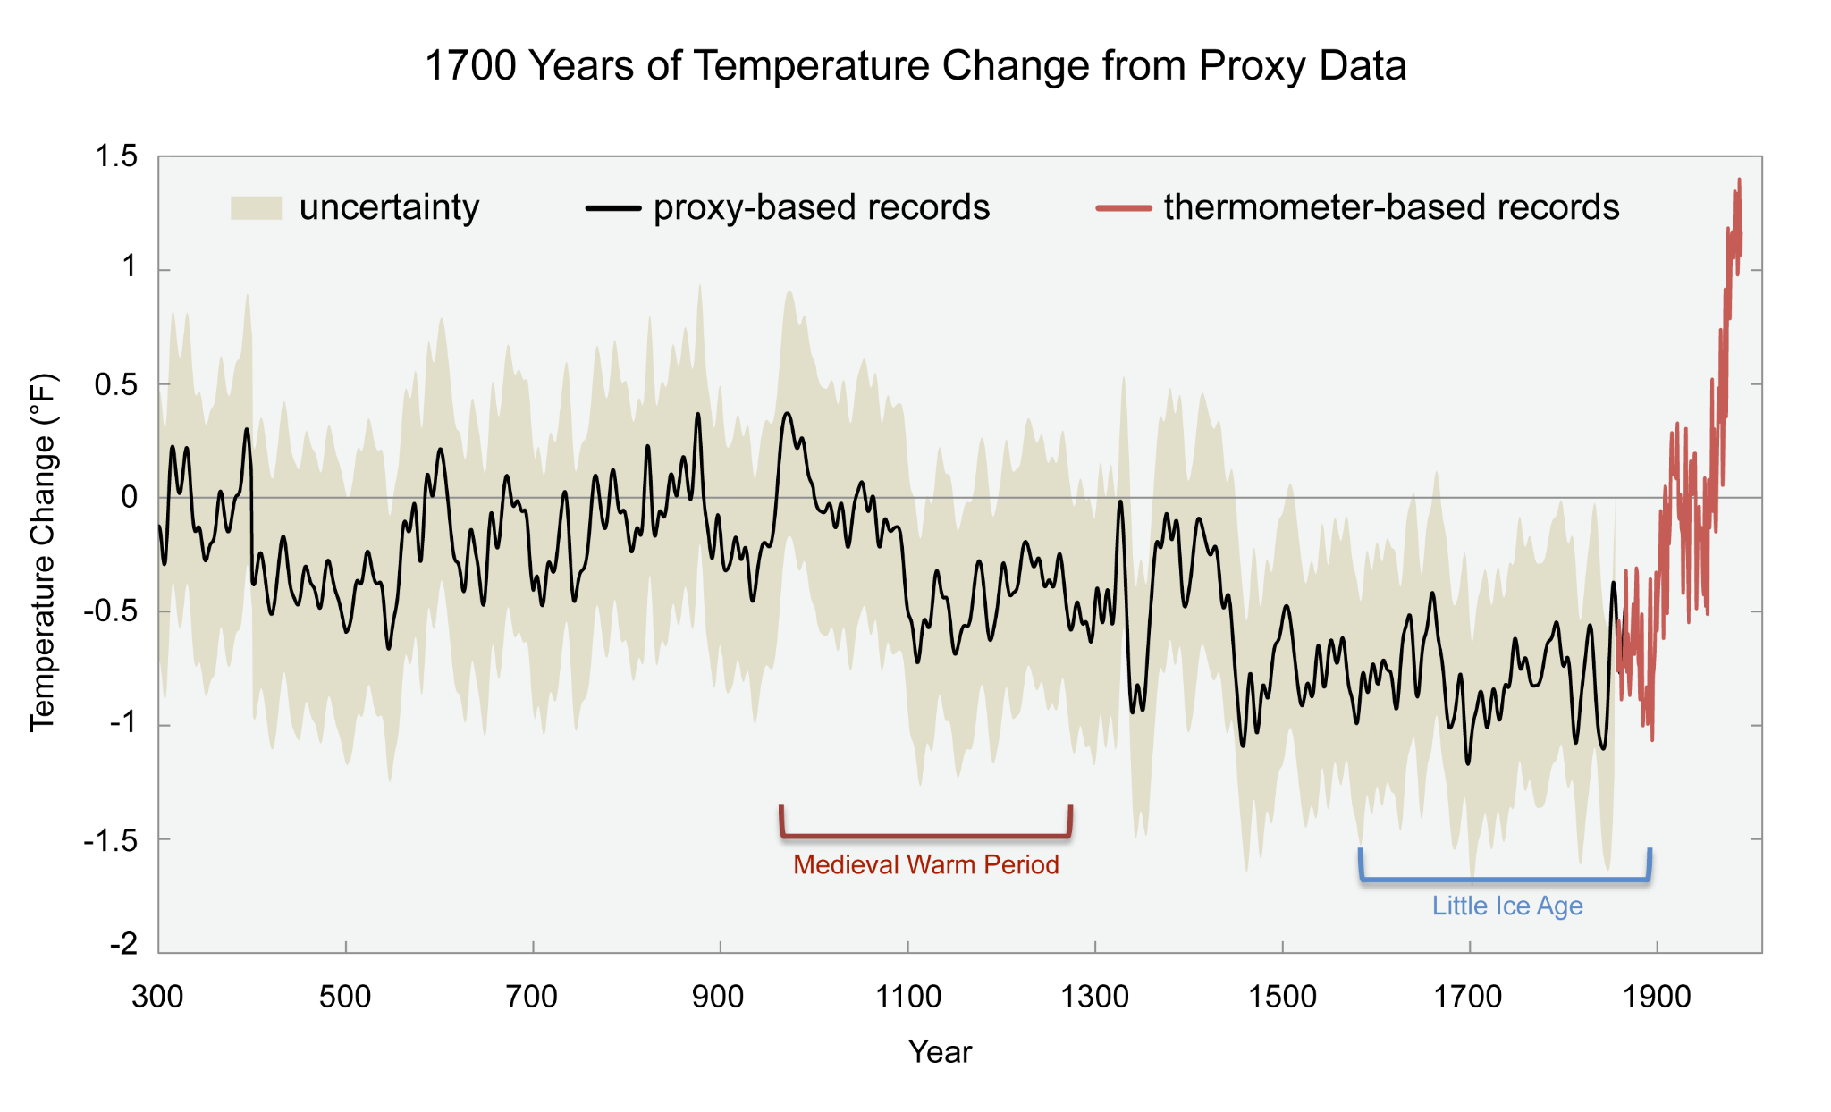
Notes:
Figure 34.5 from U.S. National Climate Assessment
Temperature data over 1700 years
https://data.globalchange.gov/report/nca3/chapter/appendix-faqs/figure/caq-1700-years-of-global-temperature-from-proxy-data

Slide 13
Assess a claim:
Claim: The most recent data shows an earlier bloom date because our climate is warming.
What evidence would be helpful to assess this claim?
Notes:
Part 2 activity in the teacher guide

Slide 14
Bloom Dates for Cherry Trees in Kyoto, Japan (2010-2019)
Year | Full Bloom Date
2010 | April 1
2011 | April 7
2012 | April 9
2013 | March 30
2014 | April 2
2015 | April 1
2016 | April 2
2017 | April 7
2018 | March 28
2019 | April 6
Notes:
Bloom data source: https://web.archive.org/web/20210410232540/https://www.jnto.go.jp/sakura/eng/city.php?CI=29
(Note: this website includes cherry blossom data for many other cities in Japan as well.)

Slide 15
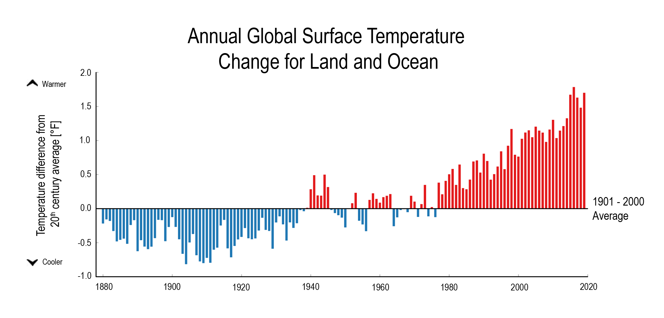
Notes:
Temperatures are increasing. Since 1880, the average global temperature has increased by more than 1.5℉. Since the 1980s, average temperatures have exceeded the last century's average every year. This graph shows the amount that global average temperature for each year differed from the average temperature over the 20th Century. Since this activity focuses on seasonal change, clarify that each bar of the graph is for a year of temperature data, so seasons are averaged.
https://www.globalchange.gov/browse/indicators/global-surface-temperatures

