Slide 1

The following slides are for use with UCAR Center for Science Education’s classroom activity, Cool Playgrounds.
Note: This file has View Only permissions. From the File menu, you can make a copy or download this file for use in your classroom. You do not need to request edit access to view, copy, or download.
Notes:
The Blooming Thermometers lesson is available at: https://scied.ucar.edu/activity/blooming-thermometers

Slide 2
Cool Playgrounds
Exploring how to stay safe at the playground when the weather is hot
Check out the lesson plan at: scied.ucar.edu/activity/cool-playgrounds

Slide 3
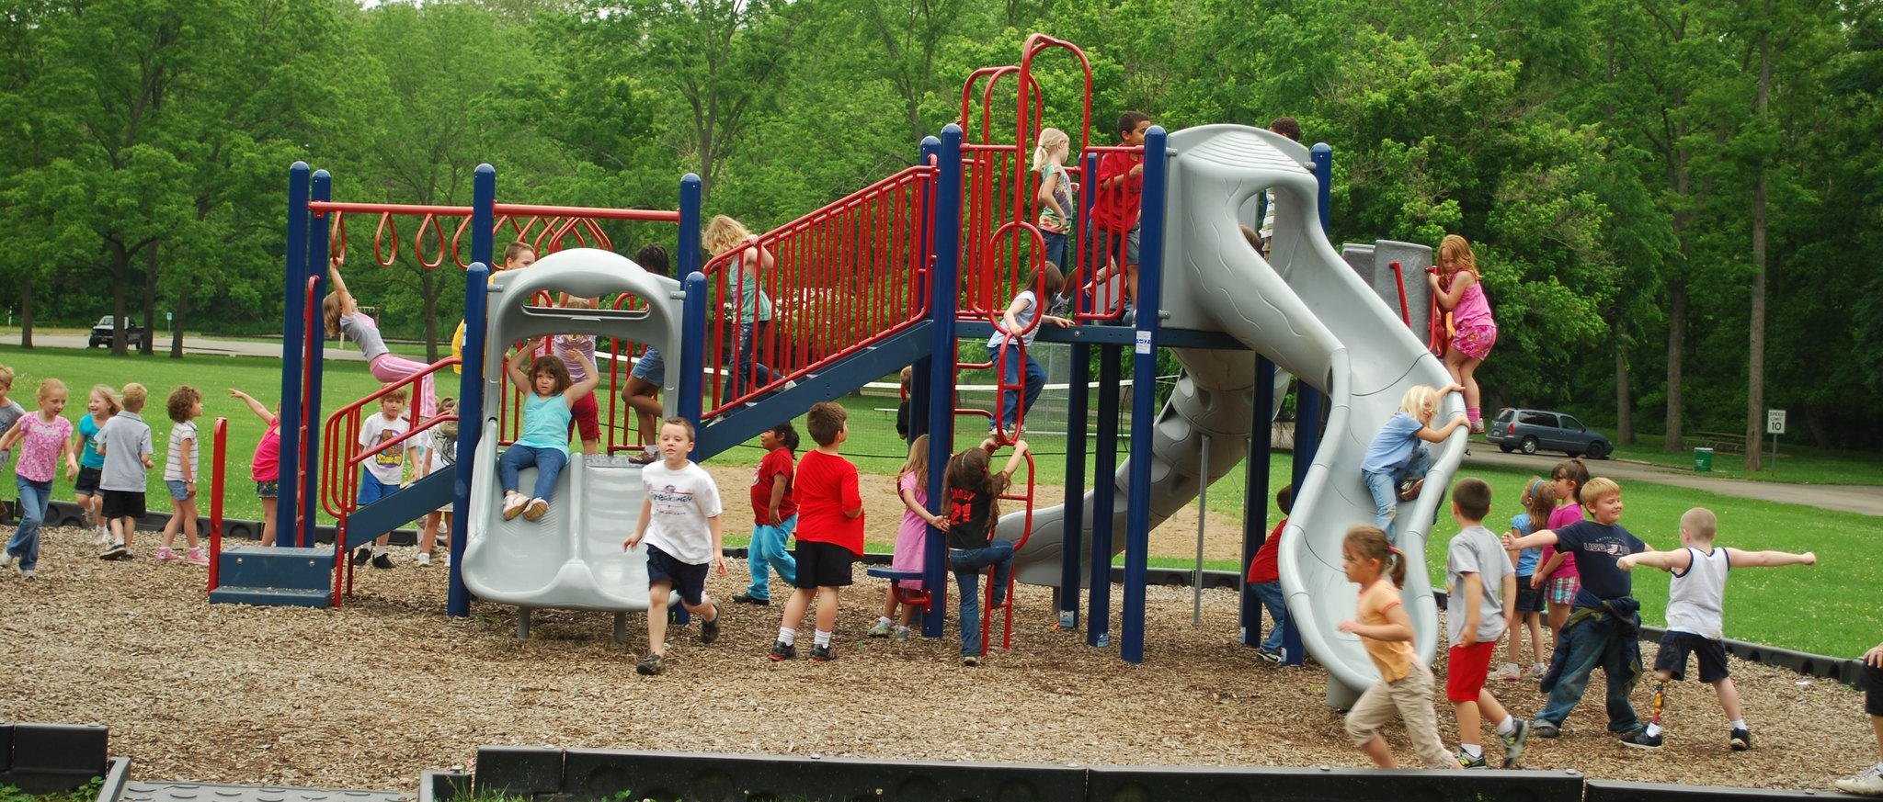
Have you ever been to a playground in hot weather? What was it like?
Credit: Clermont County Park District
Notes:
Image: https://www.flickr.com/photos/clermontcountyparks/

Slide 4
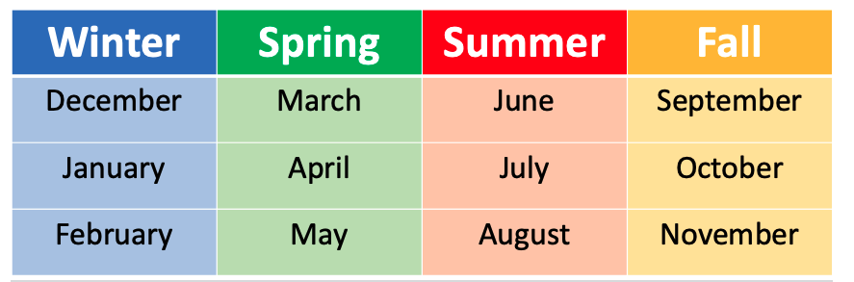
When are the hottest months?
Image: Open Snow
Notes:
These are meteorological seasons. For more information, see: https://opensnow.com/news/post/difference-between-meteorological-and-astronomical-seasons

Slide 5
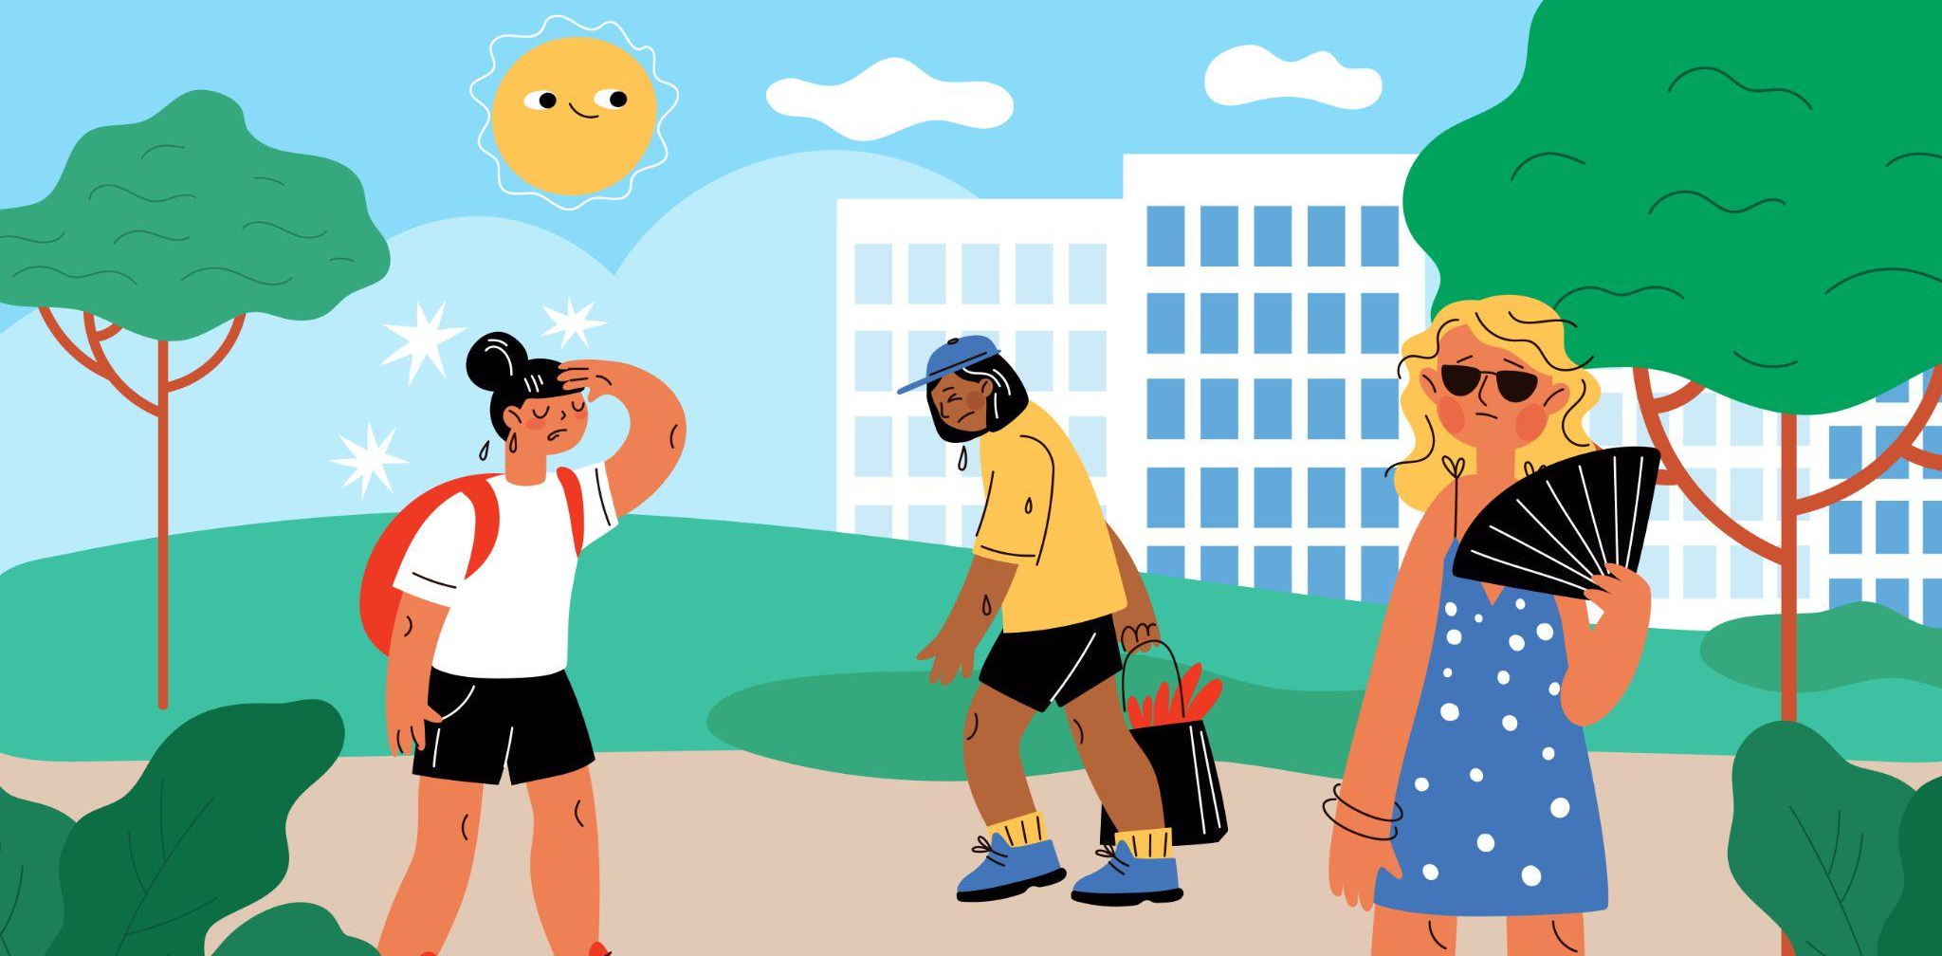
Sometimes the weather gets hotter than usual for a few days.
This is called a heat wave!
Notes:
More information about heat waves: https://www.snexplores.org/article/lets-learn-about-heat-waves
https://www.weather.gov/safety/heat-during

Slide 6
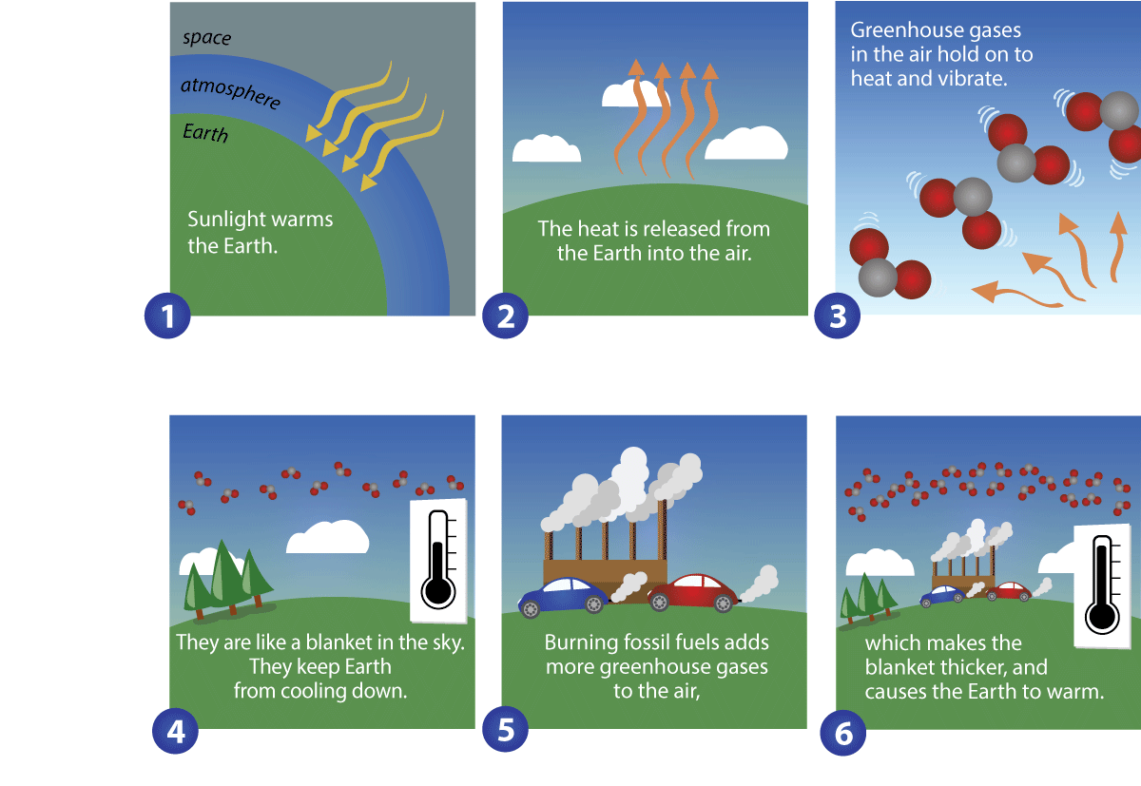
Why Earth’s climate is warming:

Slide 7
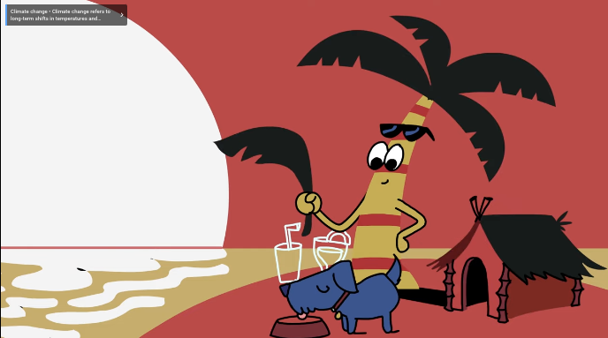
As the climate warms,
heat waves happen more often.
But we can stay safe in a heat wave!
Notes:
More information about heat waves: https://www.snexplores.org/article/lets-learn-about-heat-waves
https://www.weather.gov/safety/heat-during

Slide 8

Notes:
Find the video on SciSky for Kids
https://scied.ucar.edu/kids/video/hazardous-heat-waves

Slide 9
How to stay safe in a
heat wave!
When you’re outside,
Play in the shade,
Rest more than usual,
Drink plenty of water,
And then cool down indoors.
Notes:
More information about heat waves: https://www.snexplores.org/article/lets-learn-about-heat-waves
https://www.weather.gov/safety/heat-during

