Slide 1

The following slides are for use with UCAR Center for Science Education’s Feeling the Heat classroom activity
Note: This file has View Only permissions. From the File menu, you can make a copy or download this file for use in your classroom. You do not need to request edit access to view, copy, or download.
Notes:
The Blooming Thermometers lesson is available at: https://scied.ucar.edu/activity/blooming-thermometers

Slide 2
Feeling the Heat
This presentation is full of data and images to get you thinking. Discuss as a class the patterns you see and the reasons for those patterns.
Look for patterns in the data: How have heat waves and average temperature changed over time in Los Angeles, CA?
Consider reasons for patterns: How has global climate changed over time? How has Los Angeles changes over time, and how might that impact the heat island effect?

Slide 3
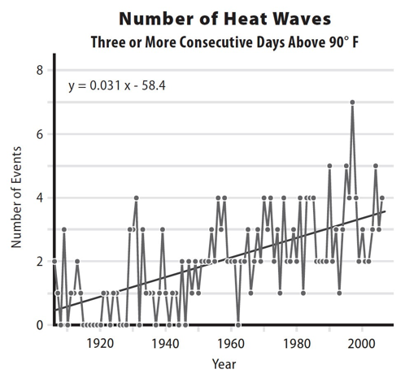
The number of heat waves in Los Angeles, CA 1900-2008.
Do you see a pattern?
How have heat waves changed through time?

Slide 4
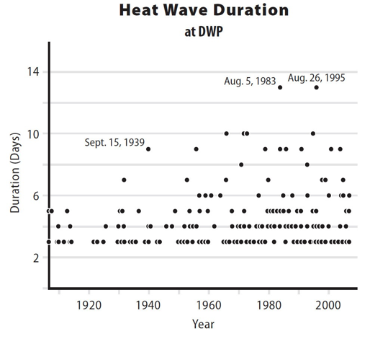
Duration of heat waves in Los Angeles, CA (measured in days.)
Has there been a change through time?

Slide 5
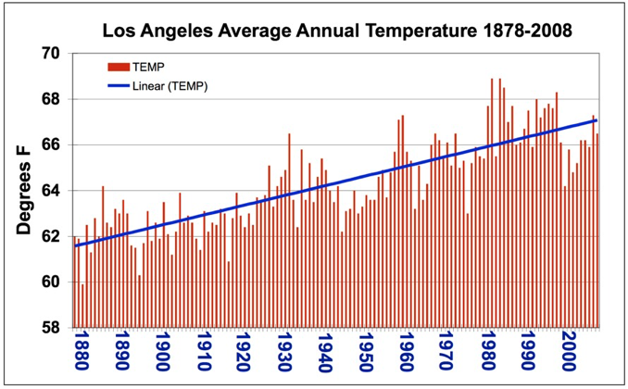
This graph shows the average temperature for each year in Los Angeles, CA.
How has the temperature in Los Angeles changed over time?

Slide 6
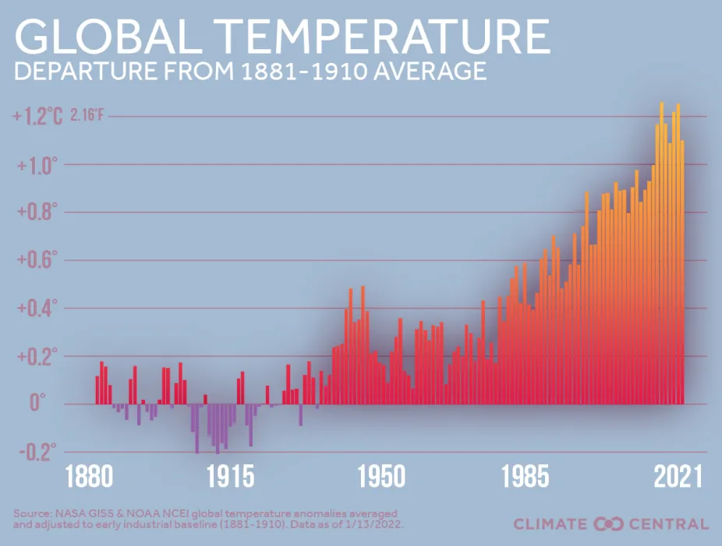
Notes:
https://www.ncei.noaa.gov/access/monitoring/monthly-report/global/202313

Slide 7
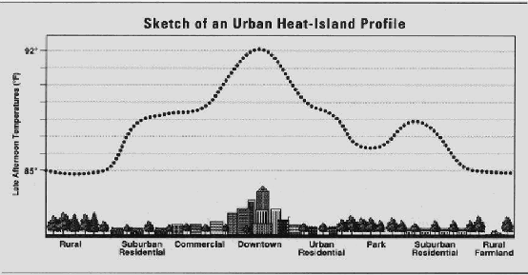
The highest temperatures are found in the most dense part of a city. That’s the urban heat island effect.
The next 3 slides show how Los Angeles has changed over time. How do you think the heat island effect has changed as the city changed?

Slide 8
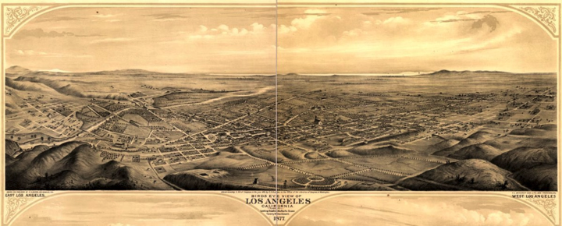
Los Angeles, CA in 1877. East LA is on the left and West LA is on the right. (Library of Congress)

Slide 9
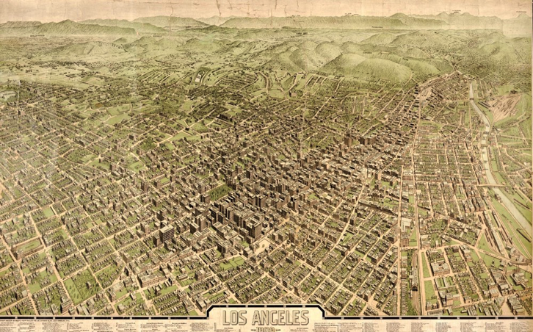
Los Angeles, CA in 1909. (Library of Congress)

Slide 10
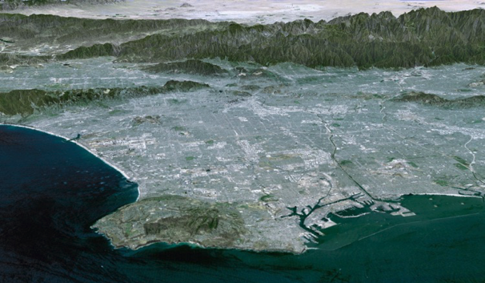
Los Angeles, CA in 2002. (NASA/JPL)

Slide 11
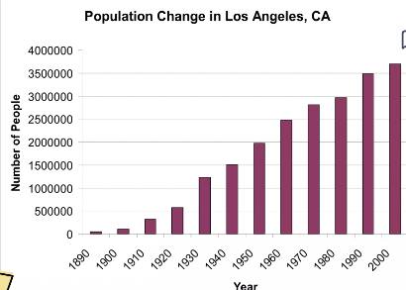
Population change in Los Angeles, CA since 1890
(Data from US Census Bureau)

